Slide 1

The Virtual Private Cloud (VPC)
Using AWS

Slide 2
About
Establish a new Virtual Private Cloud (VPC) in the Ohio region.
Institute a fresh subnet within the newly created VPC.
Guarantee the assignment of DNS hostnames for the VPC.
Confirm the configuration of the public IP address for the subnet within the VPC.
Construct an Internet Gateway and associate it with the VPC.
Amend the route tables to facilitate the flow of traffic destined for the internet.
Initiate an EC2 Instance within the new VPC.
Evaluate the connectivity.

Slide 3
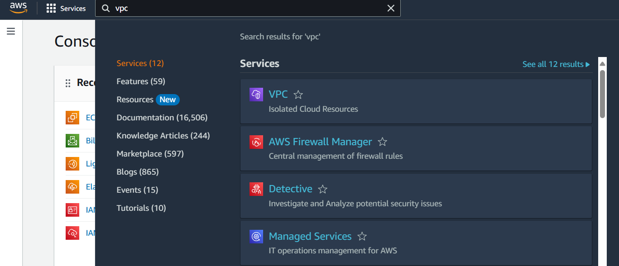
Log into your AWS account and search for VPC, hit enter.

Slide 4
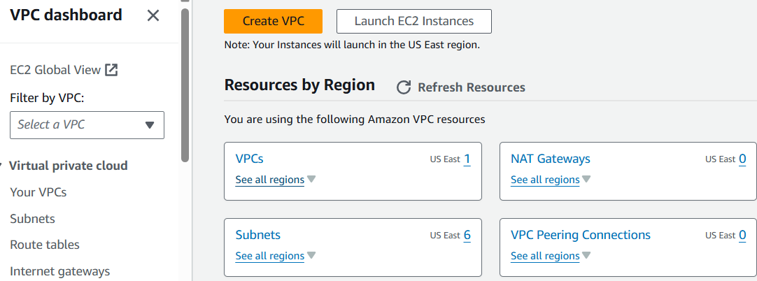
It will take you to the VPC Dashboard, next click on VPCs.

Slide 5
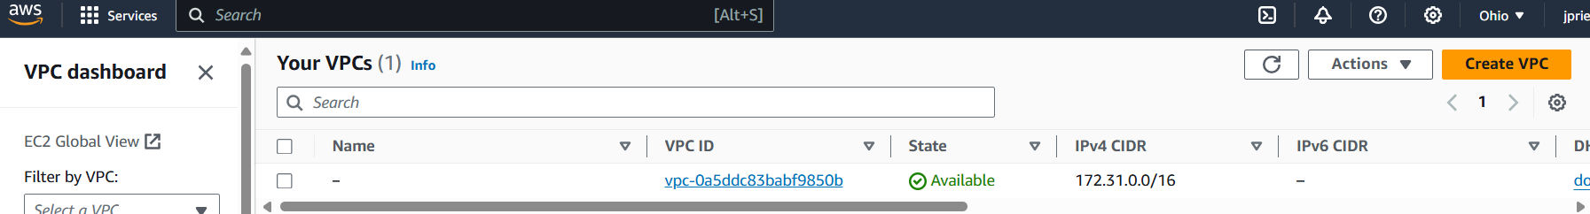
By default you will see a VPC already in your region. Go ahead and click on Create VPC on the right.

Slide 6
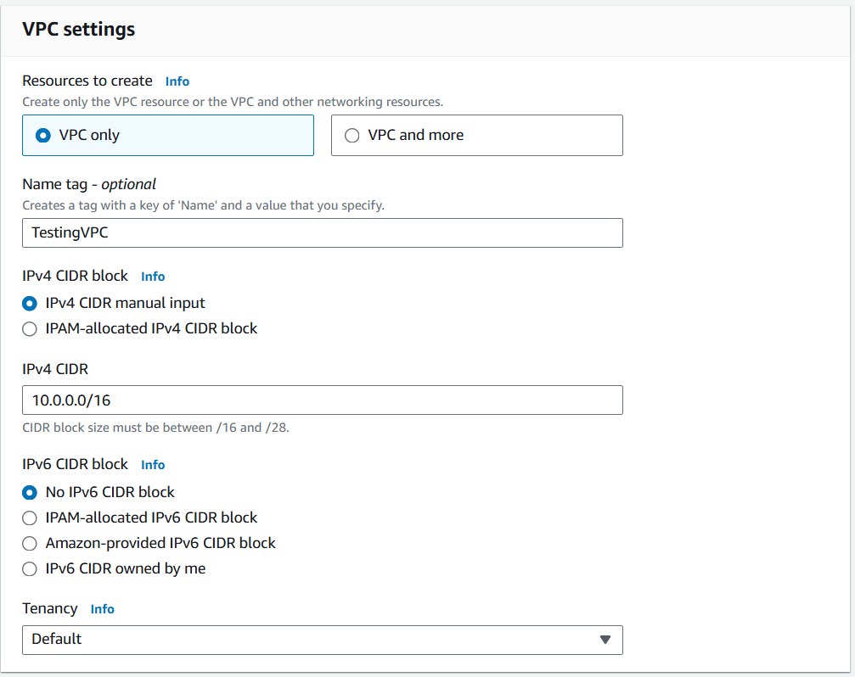
Fill in your VPC setting:
Name tag
IPv4 CIDR block
IPv4 CIDR
Tenancy
And select Create VPC.

Slide 7
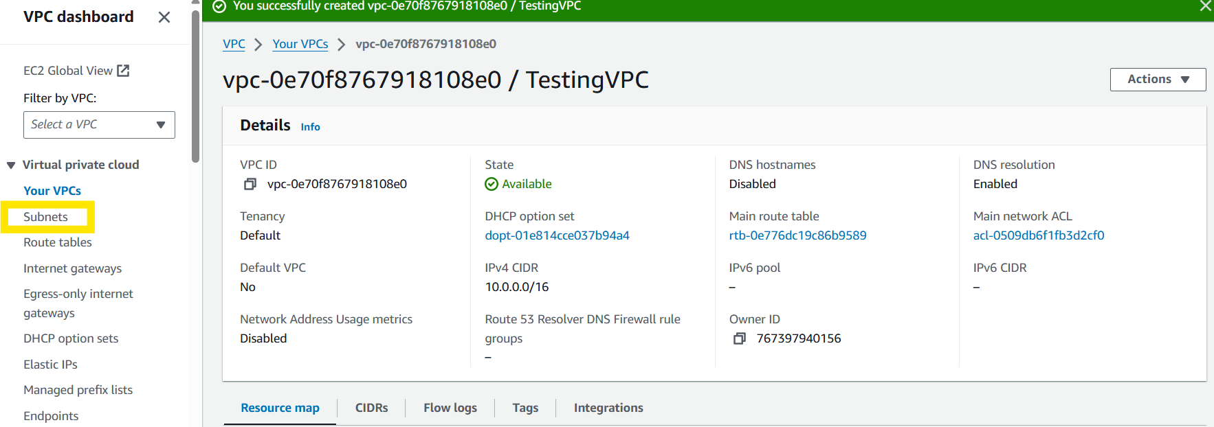
It will take you to your new VPC page, click on subnet to create a subnet.

Slide 8
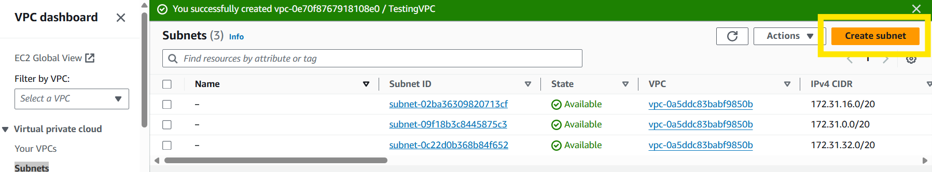
On the subnet page you will see three (3) subnets they all belong to the default VPC. Click Create subnet.

Slide 9
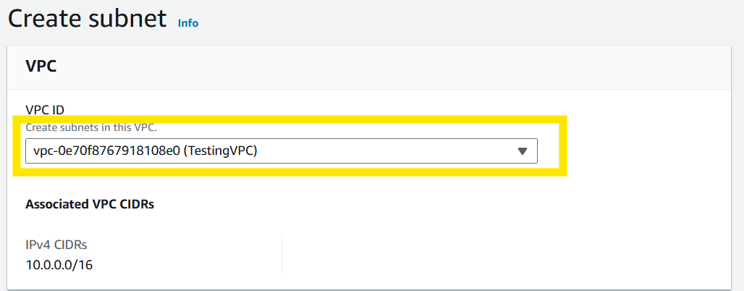
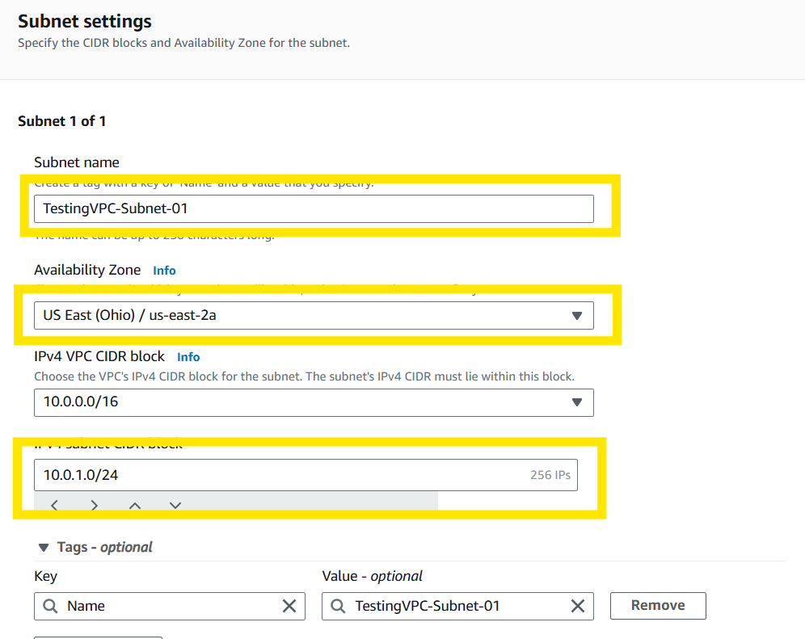
Select your VPC for your subnet.
Fill out your subnet settings. See below for example.

Slide 10
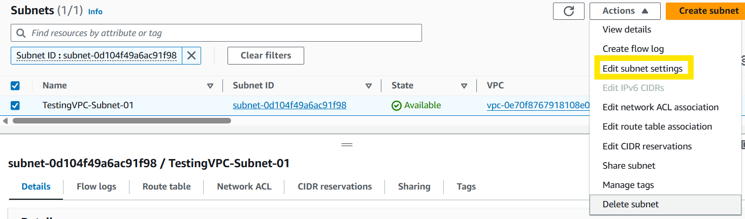
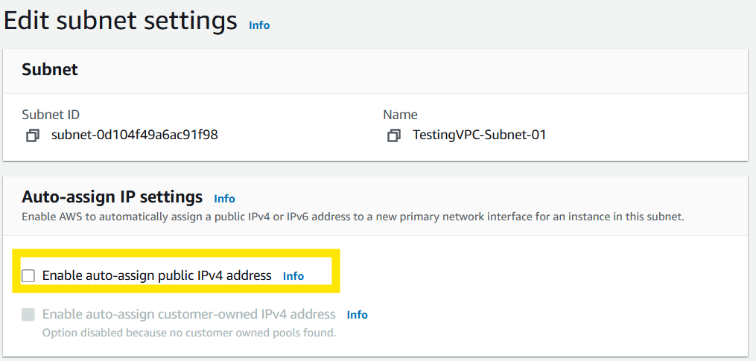
Next, we will edit the subnet settings in order to enable auto-assign public IPv4 address settings.

Slide 11
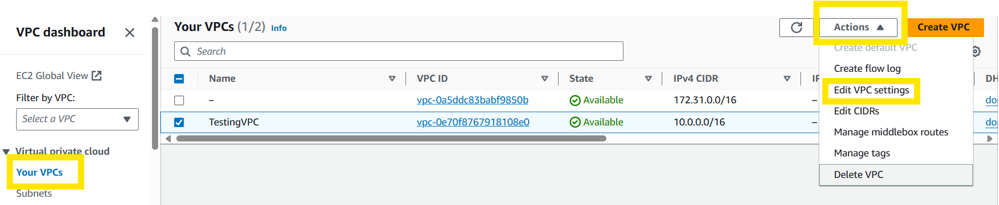
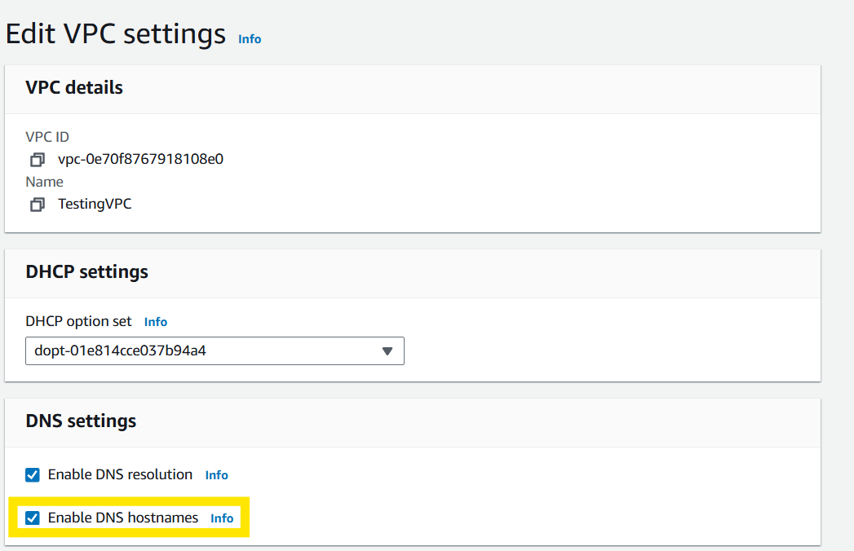
Go back to your VPC, click on Actions, then click on Edit VPC settings, in order to Enable DNS hostnames.

Slide 12
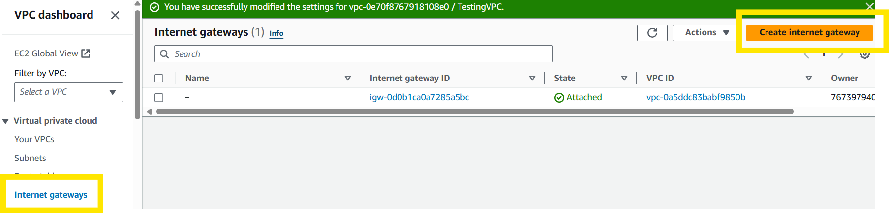
Now we will create an Internet gateway, click on Internet gateways and then click on Create internet gateway.

Slide 13
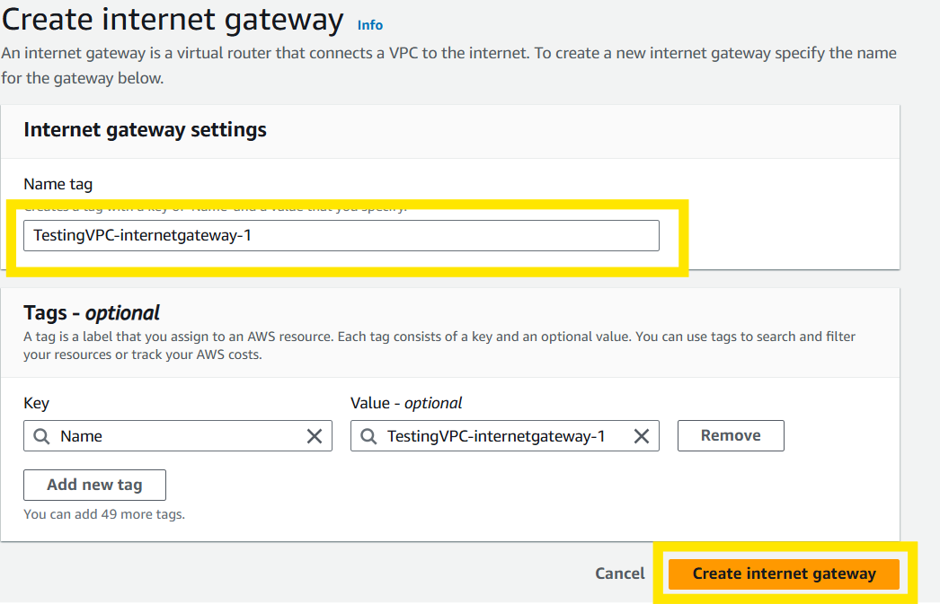
Give the Internet gateway a name and hit Create internet gateway.

Slide 14
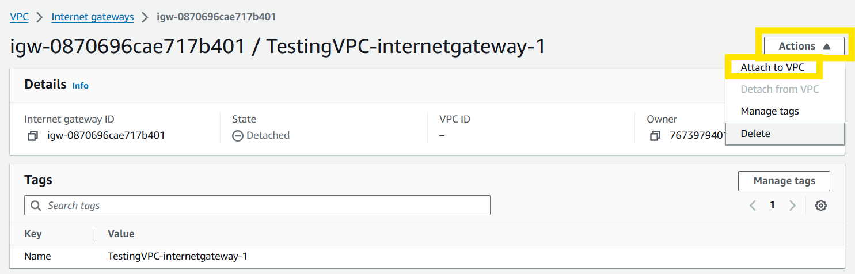
In the internet gateway window, select Actions and Attach to VPC.

Slide 15
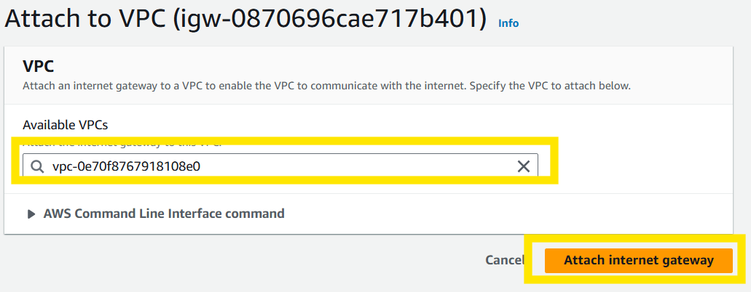
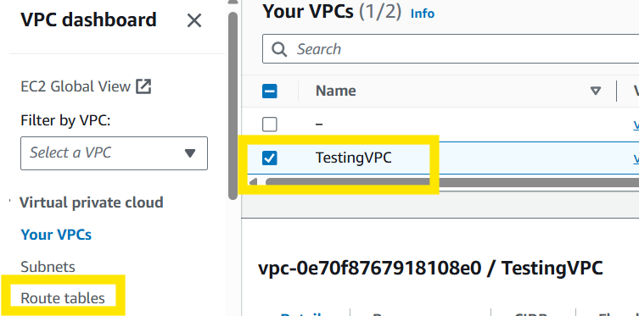
Choose your VPC and then select Attach internet gateway.
Go back to VPC dashboard, select your VPC and then select Route Tables. This is done to ensure your VPC has access to the internet.

Slide 16
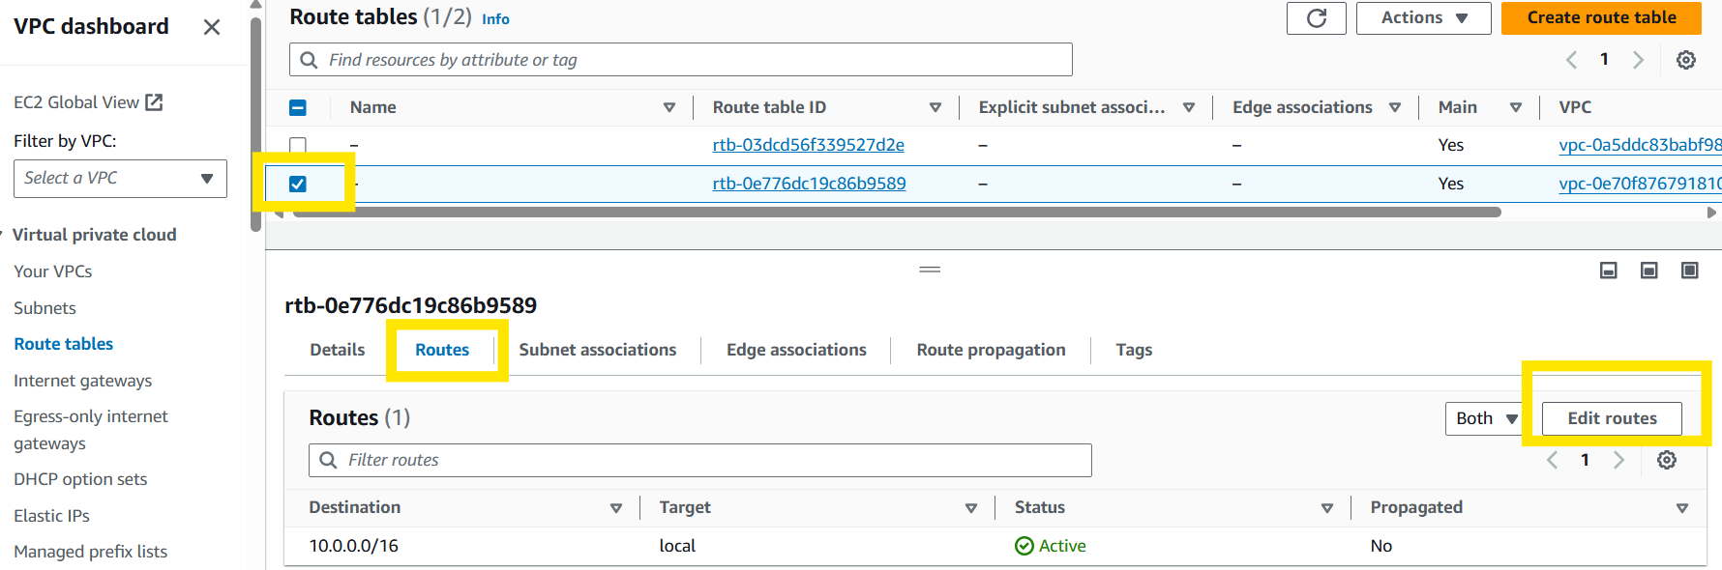
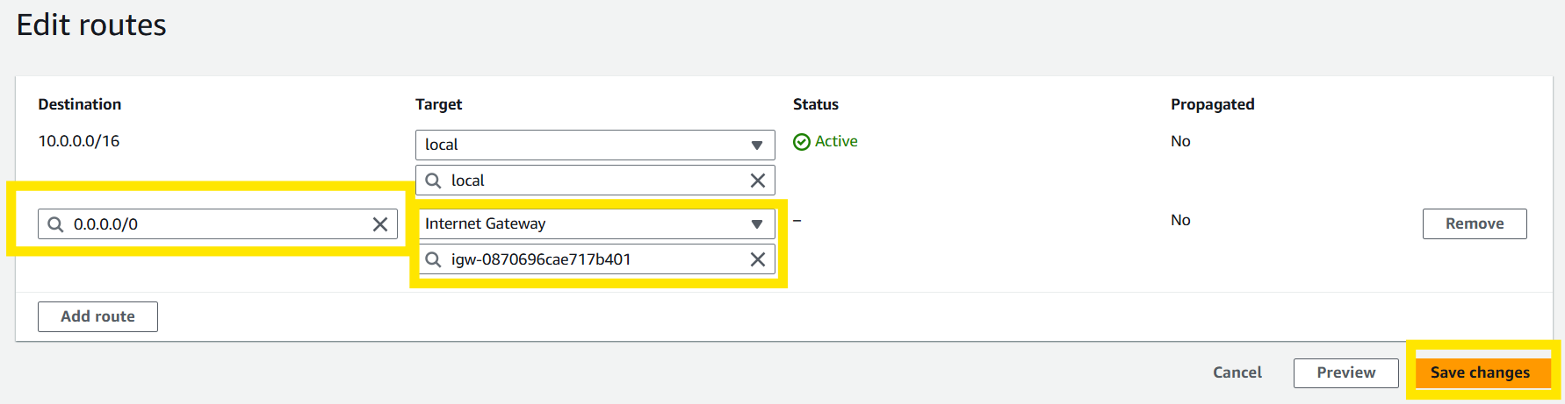
In your Route tables, select your VPC, then select routes and Edit routes.
Set up your destination address, choose your target (Internet Gateway), select your VPC, and click Save changes.

Slide 17
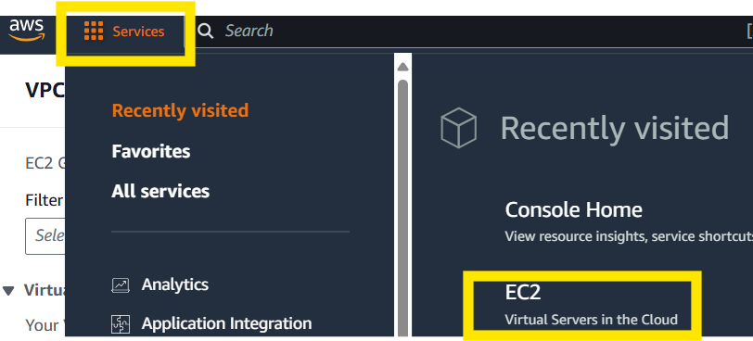
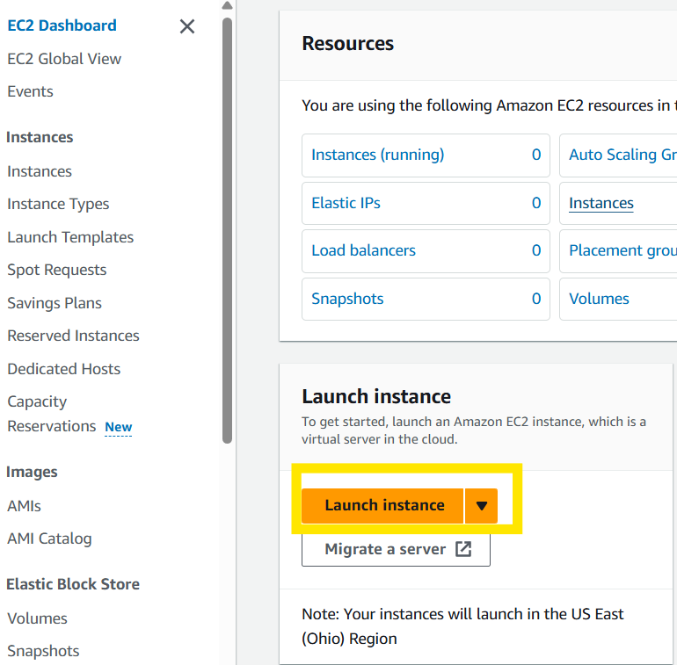
Next we will create an Instance, go to the hamburger menu, then select EC2.
On the EC2 Dashboard launch an Instance by selecting Launch instance.

Slide 18
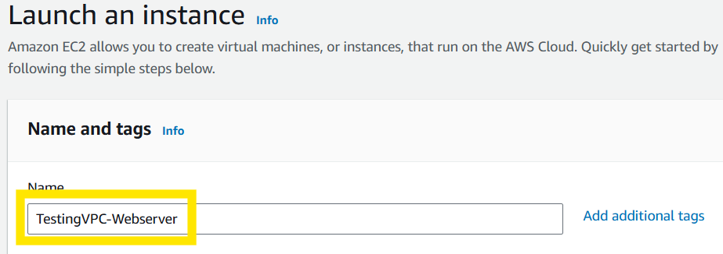
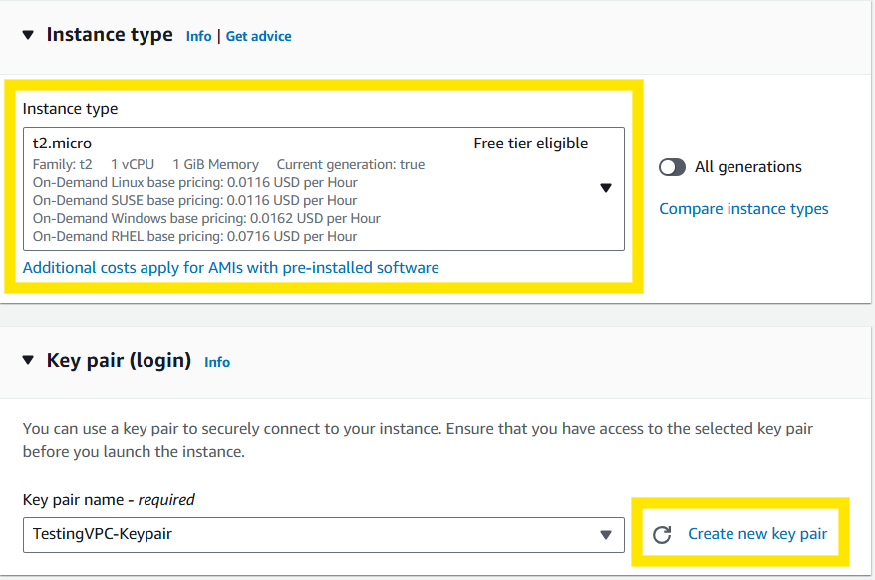
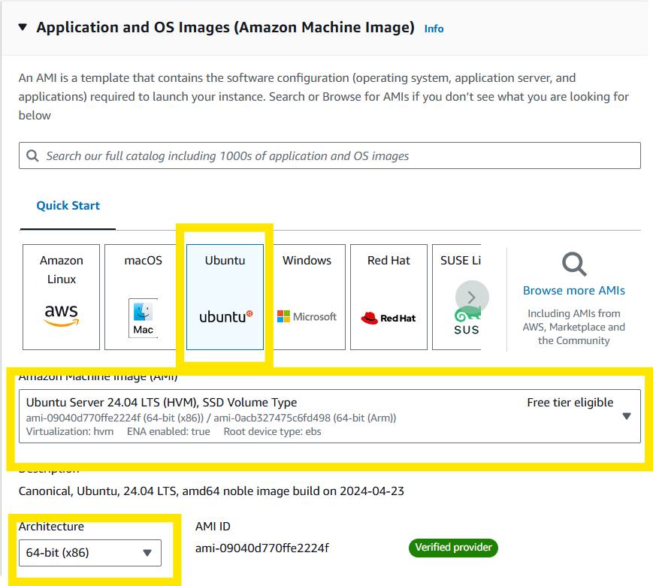
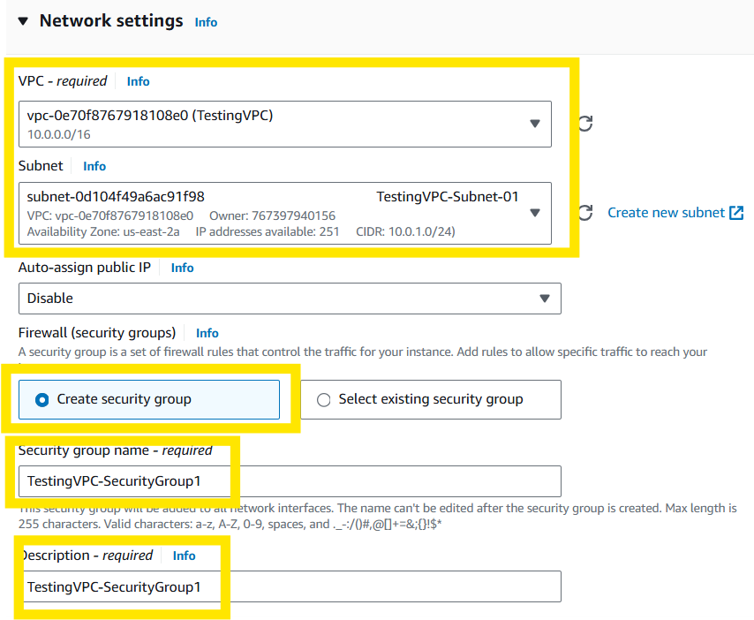
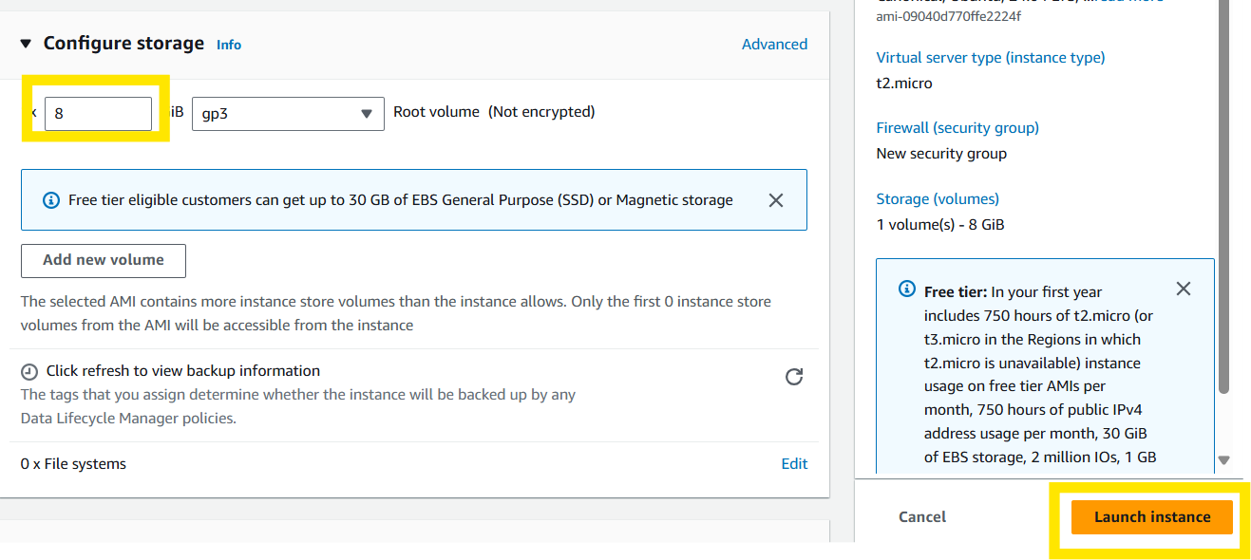
Create an instance by filling in information below, name, OS Image, Instance type, create a key pair (if you don’t have one), choose your VPC and your subnet, create a new security group, name security group and description, configure storage, and select Launch instance.

Slide 19
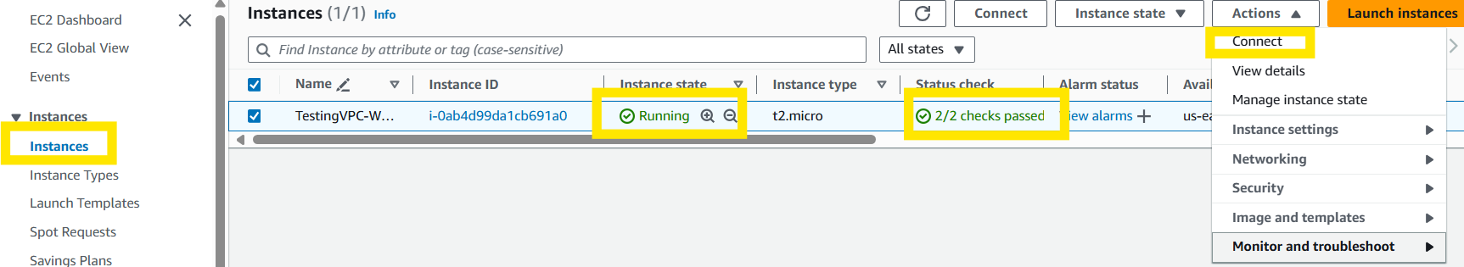
Go to the Instances page and verify that your instance is Running and the status is 2/2 checks passed. Next choose Actions and Connect.

Slide 20
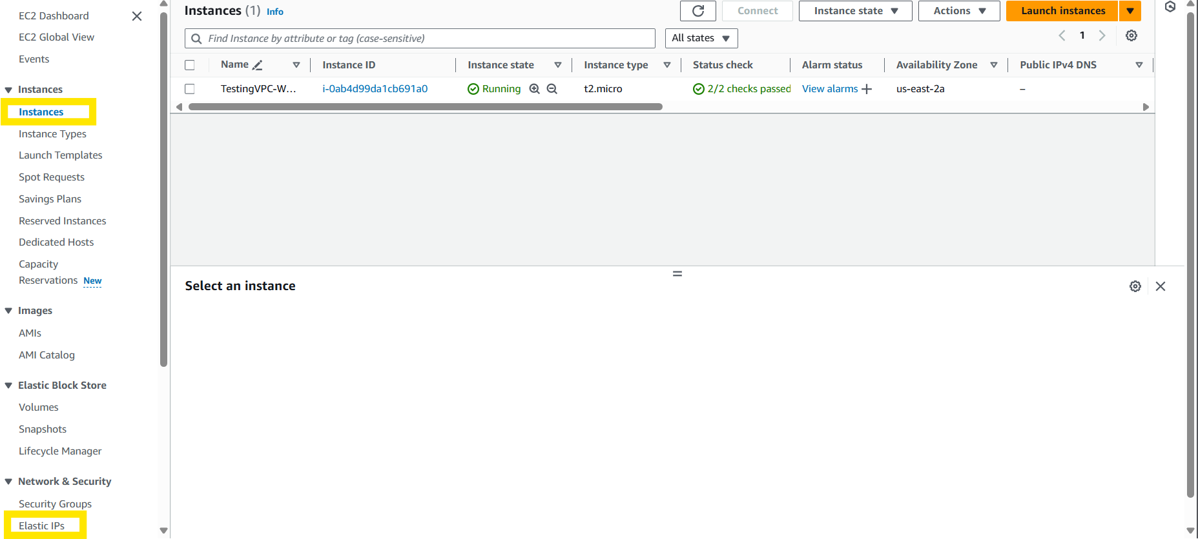
To give your instance a Public IPv4 address go to Elastic IPs.

Slide 21
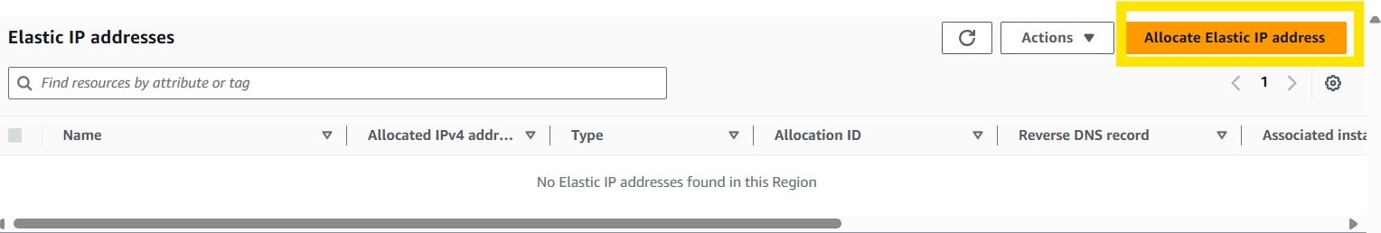
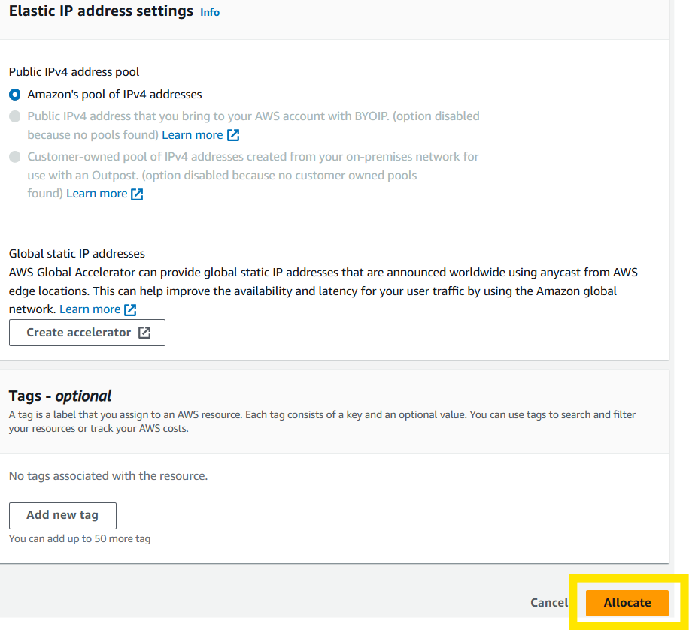
Select Allocate Elastic IP address
Click Allocate

Slide 22
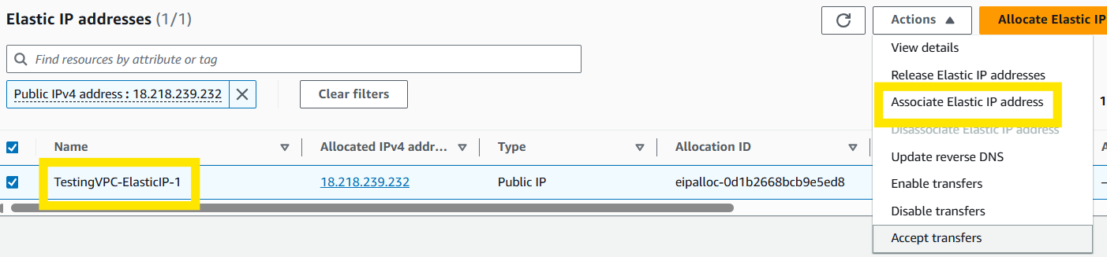
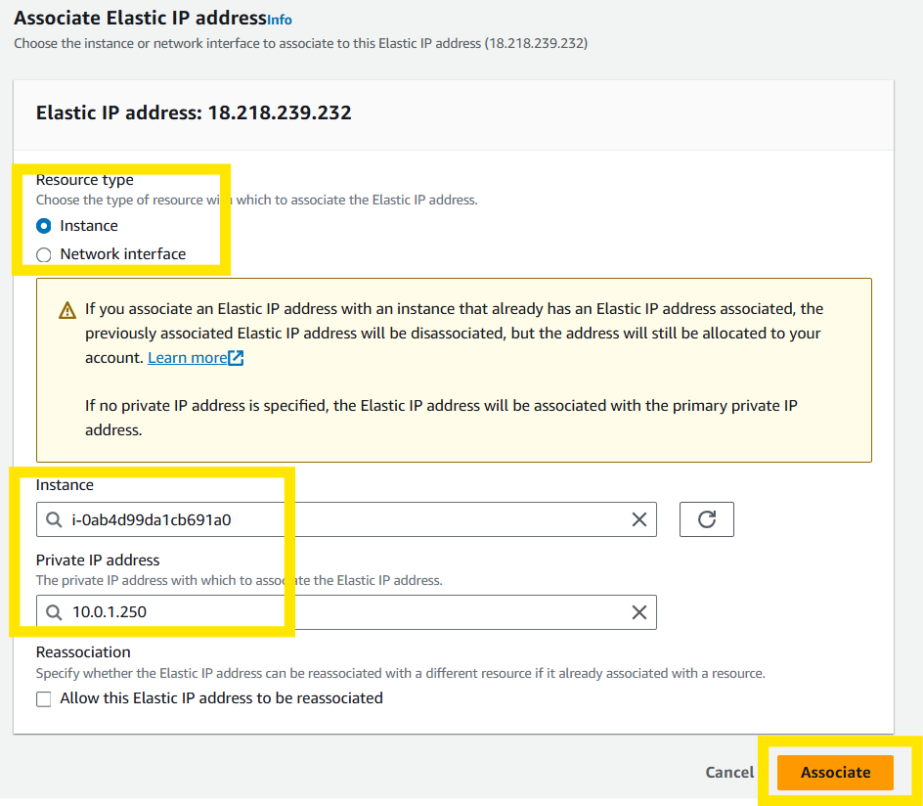
Name and Associate Elastic IP Address.
Choose Resource type, your instance, and private IP address that you would like to associate the IP address with and select Associate.

Slide 23
Name and Associate Elastic IP Address.
Choose Resource type, your instance, and private IP address that you would like to associate the IP address with and select Associate.

Slide 24
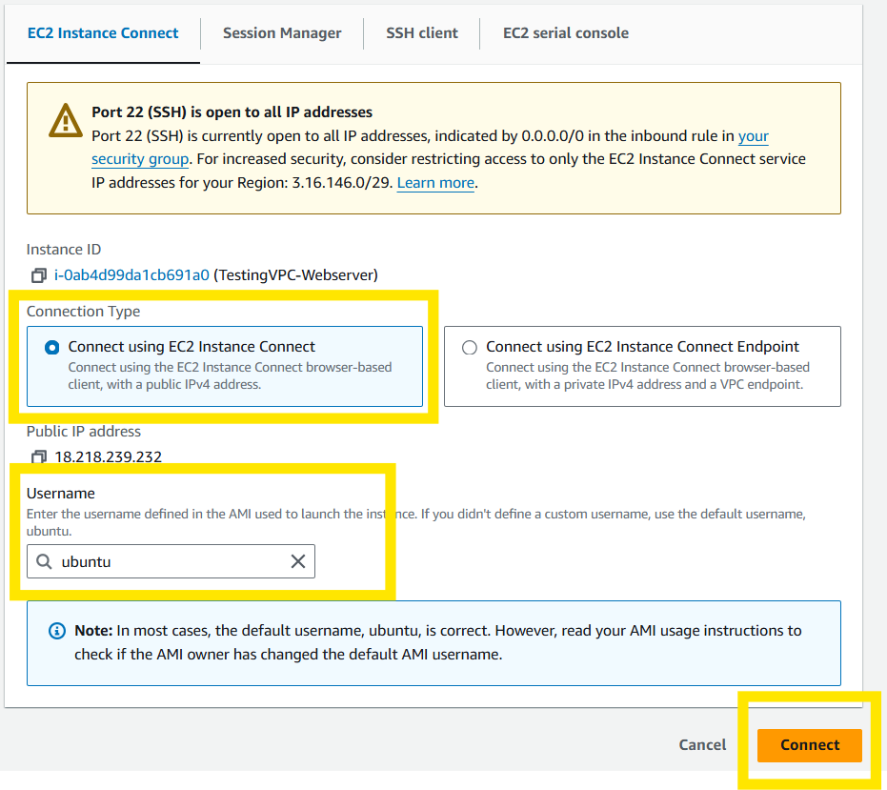
Connect using EC2 Instance Connect

Slide 25
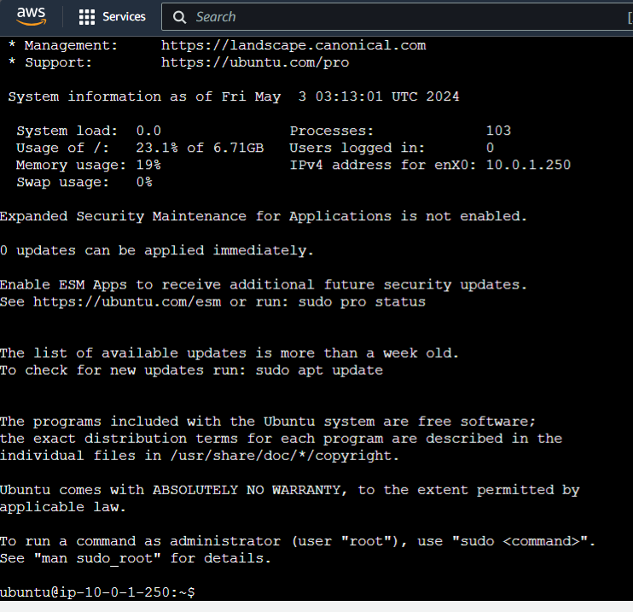
And we are connect to our server.

Slide 26


